Slide 1

The Story (Within the Story) of Cider
May 23, 2023

Slide 2
Content
Cider Universe Update
  YTD 2023 w/e May 6
The Story
  Topline Trends
  Sales, Share & Depth
  On-Shelf Metrics
The Story Within
  Tiered Performance
  Growth & Innovation Leaders
  Key Attribute Decomp
Today’s Consumer
  Cross-Category Consumption, Shopper Behavior & Demographic Trends
Looking Ahead

Slide 3
The Lay of the Land: Hard Cider
Total US xAOC + Liquor Plus + Convenience
Cider experiencing YTD $ gains across Off-Premise channels, +3.5% vs. YA
  Treading water in Grocery, with biggest gains coming in C-Stores
Universe continues to contract as Retailers shuffle sets to align with emerging trends
  This is a reality faced by almost ALL segments, not just Cider, further emphasizing the importance of communicating “wins”
However, reduced Assortment can often bring improved Efficiency as the segment evolves
  Tactical shifts in the approach & key attributes allows for stronger returns Per Item (though admittedly somewhat price-driven…)
Success is NOT universal as the landscape of Have’s and Have Nots remains across Cider families
  Regionals have momentum, Local is more volatile, but the opportunity to WIN is there for ANYONE paying attention
Specific attributes are certainly gaining more momentum than others among Consumers
  Finding the sweet spots of ABV, Packaging, Pricing & Flavor can help create separation on the shelf and across the bar
Source: NIQ Retail Measurement BEER | YTD 2023 W/E 05/06/23

Slide 4
The Story
Topline Trends
Sales, Share & Depth
On-Shelf Metrics

Slide 5
Dollar Sales Trends – Total US by Class of Trade
YTD 2023 w/e May 6, 2023
Source: NIQ Retail Measurement BEER | YTD 2023 W/E 05/06/23
Notes:
Cider only has a 68% National CWD across All Outlets (90% in Grocery, 51% in C-Stores) vs. Craft which has 93% National CWD or even Malt Liquor at 74% National CWD = Opportunities to Expand

Slide 6
Dollar Sales Trends – Time Splits
Total US xAOC + Liquor Plus + Convenience
#3 over L4W
Source: NIQ Retail Measurement BEER | YTD 2023 W/E 05/06/23

Slide 7
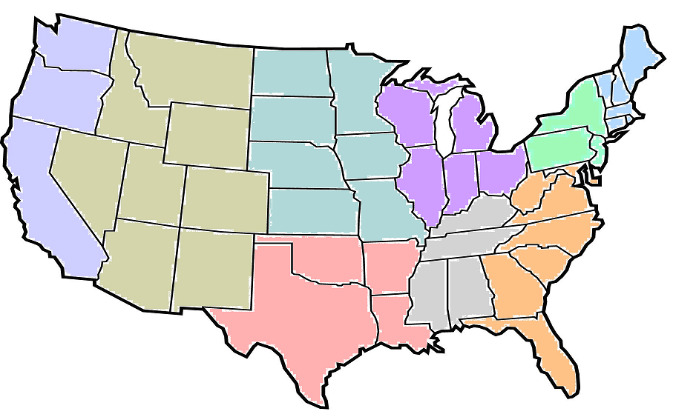
Cider $ Sales & Share Trends, by Division
*xAOC Channels ONLY*
Total US xAOC
$ Sales = +0.8%
$ Shr of Beer = 1.5%
Mountain
West
North Central
$ Sales = +1.6%
$ Shr of Beer = 1.0%
East
North Central
$ Sales = -4.8%
$ Shr of Beer = 1.0%
$ Sales = +2.5%
$ Shr of Beer = 3.0%
$ Sales = -12.1%
$ Shr of Beer = 1.2%
New England
Middle Atlantic
$ Sales = +6.6%
$ Shr of Beer = 2.3%
Pacific
$ Sales = +0.9%
$ Shr of Beer = 2.8%
$ Sales = +6.4%
$ Shr of Beer = 1.2%
$ Sales = +3.1%
$ Shr of Beer = 0.9%
South Atlantic
$ Sales = -2.5%
$ Shr of Beer = 0.6%
West South Central
East South Central
Source: NIQ Retail Measurement BEER | YTD 2023 W/E 05/06/23

Slide 8
Beer Dollar Share & Trends – by Segment
Total US xAOC + Liquor Plus + Convenience
Beer Category Dollar Sales % Chg YA = +3.2%
Dollar Share of
Total Beer Category
Dollar Share of Total
Beer Category Chg YA
Source: NIQ Retail Measurement BEER | YTD 2023 W/E 05/06/23

Slide 9
Cider Brand Count – by Year
Total US xAOC + Liquor Plus + Convenience
SKUs Beneath the Surface
Cans (+20) vs. Bottles (-100)
Singles (-70) seeing the biggest reductions
Traditional “Apple” flavors (-70) vs. All Other (-10) evening out in total counts
Brands Stable @ Retail
*Only incl. Brands w/greater than $0 Sales
Source: NIQ Retail Measurement BEER | YTD 2023 W/E 05/06/23

Slide 10
Cider SKU Count – by Year
Total US xAOC + Liquor Plus + Convenience
Assortment Adjusting @ Retail
*Only incl. Brands w/greater than $0 Sales
Source: NIQ Retail Measurement BEER | YTD 2023 W/E 05/06/23

Slide 11
Beer Category Assortment – by Segment
Total US xAOC + Liquor Plus + Convenience
Almost all Craft
Emerging Categories
Source: NIQ Retail Measurement BEER | YTD 2023 W/E 05/06/23
Notes:
Avg. # of Items for Cider rank on par with NA Beer (~8 All Outlets, ~10 in Food, ~2-3 in C-Stores, ~30 in Liquor)

Slide 12
Segment Efficiency – $ per Item per Store Selling
Total US xAOC + Liquor Plus + Convenience
Though per Item (per Store) Efficiency metrics do rank on the low end of all Beer segments…
That efficiency has shown one of the FASTEST improvements as Cider adjusts assortment to appeal to the BevAl shopper of TODAY
Emerging Comps: On a per Item basis, Cider ranks on par with FMBs, NA Beer and RTD Spirits in terms of Efficiency
Source: NIQ Retail Measurement BEER | YTD 2023 W/E 05/06/23

Slide 13
The Story Within
Tiered Performance
Growth & Innovation Leaders
Leading Attributes

Slide 14
Cider Performance by Distribution Tiers
Total US xAOC + Liquor Plus + Convenience
Only BF w/TUS CWD >20% [63% YTD]
36% $ share of Total Cider
36% collective $ share of Cider
First tier of Regional Ciders, showing strong gains
14% collective $ share of Cider, big drop-off
Fastest growing tier, 7 of 11 BFs up vs. YA
5% collective $ share of Cider, another step down
Minor $ gains, but notable Volume declines (-10%)
Like Craft Beer, this is where ~90% of BFs fall (350+ BFs)
Highly Competitive & Volatile, but Room to Grow
Competing for remaining spots on shelf after Tiers 1-4
*Custom Aggregates of BFs based on national CWD
Source: NIQ Retail Measurement BEER | YTD 2023 W/E 05/06/23
Notes:
~300 Craft BFs (of 2,600) have 1% national CWD or Higher (11% of Craft BFs) vs. 35 (of 400) for Cider (9% of Cider BFs)

Slide 15
Cider Performance by Distribution Tiers
Total US xAOC + Liquor Plus + Convenience
Only BF w/TUS CWD >20% [63% YTD]
36% $ share of Total Cider
36% collective $ share of Cider
First tier of Regional Ciders, showing strong gains
14% collective $ share of Cider, big drop-off
Fastest growing tier, 7 of 11 BFs up vs. YA
5% collective $ share of Cider, another step down
Minor $ gains, but notable Volume declines (-10%)
Like Craft Beer, this is where ~90% of BFs fall (350+ BFs)
Highly Competitive & Volatile, but Room to Grow
Competing for remaining spots on shelf after Tiers 1-4
*Custom Aggregates of BFs based on national CWD
Source: NIQ Retail Measurement BEER | YTD 2023 W/E 05/06/23
Notes:
~300 Craft BFs (of 2,600) have 1% national CWD or Higher (11% of Craft BFs) vs. 35 (of 400) for Cider (9% of Cider BFs)

Slide 16





Shelf Space Allocation…What’s Left for Cider?
Total US Food Only
All Other
NA Beer ~10
RTD Spirits ~36
Tier 1
Tiers 2-3
Tiers 4-5
How much room is left for other Regional, Local?
Source: NIQ Retail Measurement BEER | YTD 2023 W/E 05/06/23

Slide 17
Who is Winning at Retail?
Total US xAOC + Liquor Plus + Convenience
Dollar Sales
Dollar %
Chg YA
Cat Wtd Dist
CWD Chg YA
Avg. Case Price
$/$MM ACV
Distro Tier
Varied Size
Varied Footprint
Varied Price Points
Varied Velocity
Varied Portfolios
…but proof that there is room for ALL “Tiers” to make a notable impact to Cider
Source: NIQ Retail Measurement BEER | YTD 2023 W/E 05/06/23
Notes:
Over half of the T25 GROWTH BFs have less than 2% national CWD (Tiers 4-5)
Velocity can really resonate within a controlled geographical footprint, rivalling some of the “big” brands

Slide 18
How are the Leaders Performing?
Total US xAOC + Liquor Plus + Convenience
Dollar %
Chg YA
Case %
Chg YA
Cat Wtd Dist
CWD Chg YA
$ Shr of Cider
$ Shr of Cider CYA
Case Sales
Need to remember that the landscape can be VOLATILE
Size & Retail Penetration alone does NOT guarantee success…
…though it sure can help maintain stability & generate incrementality
Even the “National” brands are continuously vying for Shelf-Space & Consumer Awareness
Source: NIQ Retail Measurement BEER | YTD 2023 W/E 05/06/23

Slide 19
What Can Recent Innovation Tell Us?
Total US xAOC + Liquor Plus + Convenience
Cat Wtd Dist
Avg. Case Price
ABV Value
Case Sales
Where is the Cider segment heading?
Any common attributes standing out?
ABV? Flavors/Styles? Packaging? Price?
NEW = Zero sales in the YA time period
Source: NIQ Retail Measurement BEER | YTD 2023 W/E 05/06/23

Slide 20
Role of Innovation for Cider
Total US xAOC + Liquor Plus + Convenience
Innovation accounting for Less of Landscape…
…but accounting for More of Annual $ Sales
Overall = Becoming More Efficient / Tactical
NEW = Zero sales in the YA time period
Source: NIQ Retail Measurement BEER | YTD 2023 W/E 05/06/23
Notes:
# of NEW Cider Brands down -15% to -20% vs. YA over P3Y (vs. Total Cider -2% to -4%)

Slide 21
Key Attribute Decomp: Alcohol by Volume
Total US xAOC + Liquor Plus + Convenience
Growth TODAY appears to be centered in the Higher ABV ranges, most notably the 8-8.9% tier
9%+ tiers have also generated incremental $, though the Scale & Depth of the Landscape are much smaller
However, Brands in the 5-6.9% range still account for nearly ¾ of all Cider $ sold through retail across the US
Source: NIQ Retail Measurement BEER | YTD 2023 W/E 05/06/23

Slide 22
Key Attribute Decomp: Flavor Groups
Total US xAOC + Liquor Plus + Convenience
Berry, Stone Fruit & Tropical groups are RED HOT and tout an above-average Success Rate (% of Growing Brands)
The “Classics” still play as Apple flavors post gains (%) and strong incrementality ($) for the segment
Lately, brands featuring Fruit Combinations have collectively declined, with only ~30% of a deep bench UP in ‘23
Source: NIQ Retail Measurement BEER | YTD 2023 W/E 05/06/23
Notes:
~38% of all Cider Brands x NEW are showing some degree of growth through YTD 2023
Unflavored = Not Specified

Slide 23
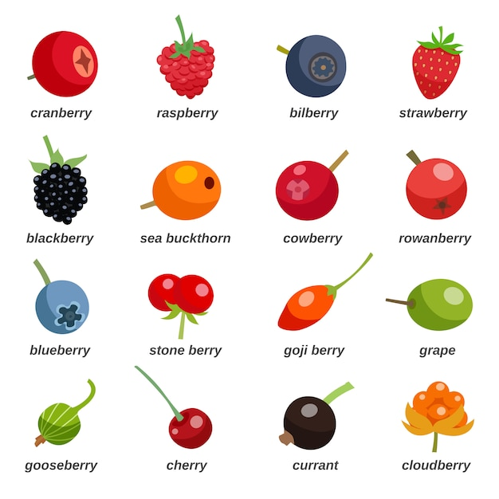

Key Attribute Decomp: Primary Flavors
Total US xAOC + Liquor Plus + Convenience
Source: NIQ Retail Measurement BEER | YTD 2023 W/E 05/06/23
Notes:
Stone Fruit = Cherry-driven
Tropical = Angry Orchard Tropical (Pineapple, Passion Fruit)

Slide 24
Key Attribute Decomp: Price Tiers (Avg. Case)
Total US xAOC + Liquor Plus + Convenience
% Dol Chg YA
Cider | Premium Cider | Super Premium Cider | Apex Cider
Total Cider % $ Chg. YA =
+3.5%
Price Tier – Total Cider | Less than $20 | $20 - $29.99 | $30 - $39.99 | $40 - $49.99 | $50 - $59.99 | $60 - $69.99 | $70 - $79.99 | $80 - $89.99 | $90 - $99.99 | Greater than $100
% Share of Ttl Cider $ | <1% | <1% | 6.5% | 58% | 22% | 6% | 2% | 1% | <1% | 3%
% Contribution to $ Chg | - | - | - | - | 109% | 25% | 4% | - | - | 2%
# of Brands (Approx.) | 20 | 20 | 85 | 330 | 340 | 220 | 125 | 60 | 30 | 300
Source: NIQ Retail Measurement BEER | YTD 2023 W/E 05/06/23

Slide 25
Key Attribute Decomp: Package Format
Total US xAOC + Liquor Plus + Convenience
6-Pack Cans are a workhorse in terms of Growth & Incrementality, though 12-Pack Cans are also on the fast track
Single-Serve Cans are emerging in the form of 19.2oz, and this is NOT purely innovation-driven growth either
Bottles in general remain in decline, though it is 6-Packs in particular that have lost their #1 rank to 6-Pack Cans
Source: NIQ Retail Measurement BEER | YTD 2023 W/E 05/06/23
Notes:
4/16 Cans flat YoY, but this is primarily due to ONE SKU (Seattle Cider Dry Cider), format is +7% excluding this ONE SKU

Slide 26
Key Attribute Decomp: ABV x Format [T25/B25]
Total US xAOC + Liquor Plus + Convenience
6-Packs across the board showing losses in mid-range ABVs (5%, 6%)
12-Packs, Can or Glass, winning with mid-range ABV (5%)
Higher ABV (8%, 9%) winning in 6-Pack Cans
Detail
Source: NIQ Retail Measurement BEER | YTD 2023 W/E 05/06/23
Notes:
4/16 Cans flat YoY, but this is primarily due to ONE SKU (Seattle Cider Dry Cider), format is +7% excluding this ONE SKU

Slide 27
Key Attribute Decomp: ABV x Format [T25/B25]
Total US xAOC + Liquor Plus + Convenience
Large-format Singles
16oz in mid-range
Mix Packs / Seasonal SKUs
Various BTLs
Small-format Singles
Higher ABV (8%)
Source: NIQ Retail Measurement BEER | YTD 2023 W/E 05/06/23
Notes:
4/16 Cans flat YoY, but this is primarily due to ONE SKU (Seattle Cider Dry Cider), format is +7% excluding this ONE SKU

Slide 28
Today’s Consumer
Cross-Category Consumption
Purchase Frequency
Demographic Trends

Slide 29

Cider Consumer: Cross-Category Consumption
Among Cider Drinkers, Which of the following Alcoholic Beverage categories have you consumed in the P12M?
BWC Key Takeaways
Among the ~300 Cider Consumers in the survey, a whopping 90% indicated that they ALSO consumed Hard Seltzer within the Past Year
Not far behind was the Wine category, showing cross-over consumption among 85% of Cider respondents
FMBs, another flavor-forward segment, showed one of the lower cross-over rates at 68% vs. its peers although this is still a HIGH percentage in general
Among the suggested categories, RTD Spirits ranked the lowest, although HALF of the Cider consumers still indicated consumption & since this is a national survey, results could be impacted by availability @ retail
NET IMPACT = High rate of Cross-Category Consumption among Cider consumers which boils down to competing for OCCASIONS
*April 2022 Cider Consumer Survey (n= ~300)

Slide 30
Cider Consumer: Cross-Category Consumption
Male vs. Female
Among Cider Drinkers, Which of the following Alcoholic Beverage categories have you consumed in the P12M?
Males = “Core” Beer more of a Threat to Cider Occasions
Females = Lower % of Crossover vs. Males, though still widely apparent
*April 2022 Cider Consumer Survey (n= ~300)

Slide 31
Cider Consumer: Consumption Behaviors
YES, it is true that…
Cross-Category Consumption is HIGH
Threat of Lost Occasions is REAL
Consumption Frequency STAGNANT
…but, it is ALSO true that…
Still a solid subset showing INCREASE
Small % indicated a DECREASE (Loyal)
Retaining occasions still a WIN in ‘23
*April 2022 Cider Consumer Survey (n= ~300)
Notes:
<10% of Cider drinkers stayed within 1-3 BevAl categories…only ONE said they were loyal to ONLY Cider [29M Los Angeles, CA]

Slide 32

Big Picture: BevAl Shopper Demo, by Preferred Cat
Male vs. Female
Screener: Which of the following alcoholic beverages do you consume **most often**?
Skews Female “Balanced” Skews Male
WINNING TODAY
n = 1,457
n = 267
n = 251
n = 269
n = 272
WINE skews heavily Female, well above the 60/40 split we saw among total survey respondents
RTDs also skew toward the Female demo, though not as heavily as Wine, falling closer in line with the survey avg.
SPIRITS are showing the most even split among the categories, nearing much more of a 50/50 break
BEER skews heavily Male, even in a survey where the respondent base skewed toward Female drinkers
*Jan 2023 BevAl Consumer Survey (n = ~1,500)

Slide 33
Big Picture: BevAl Shopper Demo, by Preferred Cat
Age Group
Screener: Which of the following alcoholic beverages do you consume **most often**?
Skews Younger “Balanced” Skews Older
WINNING TODAY
n = 1,457
n = 251
n = 269
n = 272
n = 267
RTDs really resonate among “NEW” drinkers, but have yet to break through among the older Demos
“Traditional” SPIRITS have shown the most balanced response among Age Demos, slightly skewing Younger
BEER notably under-indexes among 21–29 YO Respondents vs. the Average when it comes to “Primary” consumption
WINE over-indexes among the 55+ consumers though it does show the ability to resonate among Younger Demos too
*Jan 2023 BevAl Consumer Survey (n = ~1,500)

Slide 34
Big Picture: BevAl Shopper Behavior, by Preferred Cat
Shopper Frequency
Thinking about all the beverages you have Purchased in 2022. Which best describes your behavior vs. 2021?
BWC Key Takeaways
Among consumers who identified Wine, Spirits and RTDs as their PREFERRED category, each indicated that they made purchases of that category MORE often in 2022 vs. 2021
The same can NOT be said about BEER, where the highest % of preferred drinkers said that they made the SAME frequency of purchases in ‘22
Preferred Beer drinkers carried their behavior into cross-category purchasing too, exhibiting a similar array of frequency across Wine & Spirits occasions
Preferred Spirits drinkers spread the wealth, showing highest % of incr. purchase frequency among Non-Spirits categories, particularly RTDs
ALSO…All drinkers showing uptick in NA purchases
*Jan 2023 BevAl Consumer Survey (n = ~1,500)

Slide 35
Looking Ahead

Slide 36
The Story Within the Story of Cider
Cider is Gaining Momentum @ Retail & has become a true Standout in C-Stores
Shelves still HIGHLY Competitive, competing for Limited Space in Squeezed Segment
Cider stats prove its Efficiency & Value vs. other emerging segments → FMB, NA Beer, RTD Spirits
Enhanced Strengths of Cider lie beneath the surface, but landscape can Quickly Become Volatile
Brands do NOT Have to Over-Extend & spread themselves wide to make a significant splash
Growth & Innovation skew toward Higher ABV values, a trait shared with other BevAl segments
While Apple still very much in play, indiv. Berry, Stone Fruit (Cherry) & Tropical flavors also resonating
Loyal Cider shoppers have demonstrated that Price is Not a Deterrent, assuming Quality backs it up
Cans winning via all Shapes & Sizes; Foundational 6/12, Fast-Tracked 12/12 and Emerging Singles
Consumer is Evolving. New LDA ≠ Legacy Drinkers. More Cross-Cat, Flavor-Seeking, Occasion-Driven
Source: BUMP Williams Consulting

Slide 37
What Does This Mean for Me?
Own Your Backyard – Selective Distribution by Class of Trade, Neighborhood & Stores
Know Your Consumer – Stay Focused on Demographics & Purchase Behavior.
Portfolio Discipline – SKU-icide is NOT a Path to Success.
Reassess Business Plans and Strategies – Integrate Best in Class Business Practices.
Make Fact-Based Decisions – Pricing, Innovation, Packaging, and Expansion.
Source: BUMP Williams Consulting

Slide 38
What Else Would you Like to See?
Please reach out & let us know….
Source: BUMP Williams Consulting

Slide 39

Thank You!
BUMP Williams Consulting
BUMP Williams / bump@bumpwilliamsconsulting.com / (203) 338-1207
Dave Williams / dave@bumpwilliamsconsulting.com / (203) 257-8795
Brian ‘BK’ Krueger / bk@bumpwilliamsconsulting.com / (512) 656-7650

Slide 40
Appendix

Slide 41
Content
You’ve heard the headlines and the general trends for Cider.
Join Brian "BK" Krueger and Dave Williams from Bump Williams Consulting on Tuesday, May 23, 2023 at 11:00 AM Pacific to dive in a little deeper and really take a look at the KPI’s that matter and how you can apply them to your own situation, presentations, insights, and decisions.
You can expect to hear more of the story on:
  Cider Velocity
  Runway for the Future
  Role of Flavor
  Pack Size and Type
  Innovation
  Regional Power
  Modern Bev Alc Consumer.

Slide 42
Top Cider Vendors ($000 Sales)
Total US xAOC + Liquor Plus + Convenience
Dollar %
Chg YA
Case %
Chg YA
Cat Wtd Dist
CWD Chg YA
$ Shr of Cider
$ Shr of Cider CYA
Case Sales
Source: NIQ Retail Measurement BEER | YTD 2023 W/E 05/06/23

Slide 43
Cider Brand Family Portfolio Pricing & Change
Total US xAOC + Liquor Plus + Convenience
Top 25 Cider Families – Avg. Case Price
$175.32
Top 25 Cider Families – Avg. Case Price CYA
Source: NIQ Retail Measurement BEER | YTD 2023 W/E 05/06/23

Slide 44
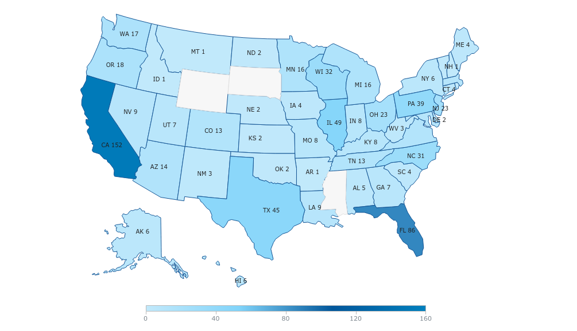
Campaign Details
Cider Consumer Survey Sample
Respondents by State
___________________ Varies by Category Questions ___________________ 21-65 Age Range ___________________ Under $20,000 to $1M+ Income Range |  | ___________________ 302 Respondents ___________________ 50% M / 50% F Sex ___________________ 100% TUS Location

Slide 45
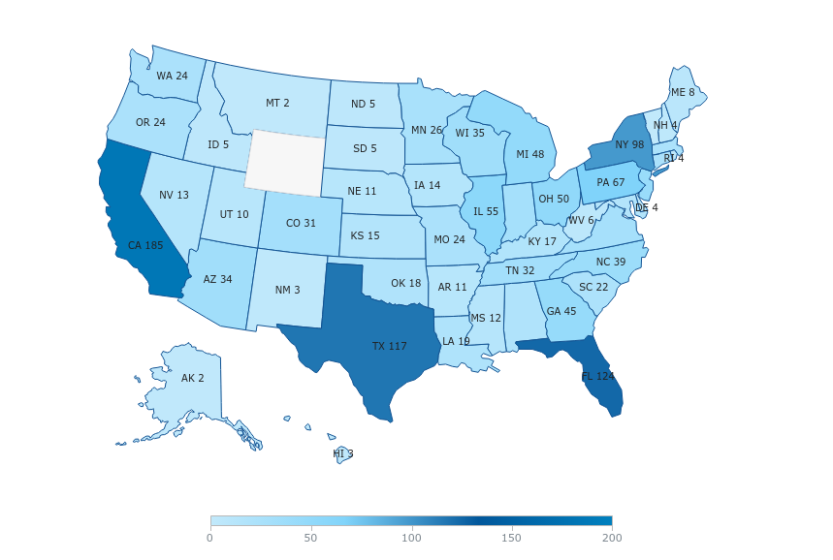
Campaign Details
BevAl Consumer Survey Sample
Respondents by State
___________________ Varies by Category Questions ___________________ 21-65 Age Range ___________________ Under $20,000 to $1M+ Income Range |  | ___________________ 1,457* Respondents ___________________ 41% M / 59% F Sex ___________________ 100% TUS 23%/22%/36%/19% West/Midwest/South/Northeast Location
*Total audience fielded to hit individual category thresholds

Slide 46
Category Loyalty & Lost Occasion Threats
In addition to your [Preferred] Category, what other Alcoholic Beverages have you consumed in the P1Y? (Select all that apply)
Lowest % of drinkers identifying additional category of consumption
Indicates High Single-Category Loyalty (by comparison)
Beer/RTD lowest on cross-cat threat rankings
Highest crossover w/Spirits vs. Lowest crossover w/RTDs
Beer was universally lowest choice among other cat-loyal drinkers
Beer losing occasions to W/S/RTD, but not “stealing” back at a similar rate
Notable crossover with Spirits
…but well below average crossover with Beer/RTD categories
More likely to LOSE occasions to Spirits than Spirits are to lose them back to Wine (74% vs. 66%)
Highest crossover w/Spirits, which makes sense given Spirits-based SKUs
Lowest crossover w/Beer when it comes to potential LOST occasions
Highest crossover w/Non-Alc of the 4, Younger Drinkers more accepting?
*Jan 2023 BevAl Consumer Survey (n = ~1,500)

Slide 47
Retained vs. New Consumer Preference
Thinking of your [Preferred] Category today, was there another point in your life when you would have answered differently? If so, which alcoholic beverage have you Previously consumed most often?
Over 50% of preferred Beer drinkers are long-tenured
Beer has sourced some loyalty from other categories, mostly from Spirits
Minimal crossover/preference-pivot coming from the RTD world
Most of the consumers who identified RTDs as their preferred category did NOT always feel this way
Spirits & Beer saw some of their once loyal drinkers shift to RTDs
Interestingly, it appears to be a one-way street from Beer → RTD, but not as much RTD → Beer
Most of the consumers who identified Spirits as their preferred category did NOT always feel this way = “Stealing” Drinkers / Preferred Occasions
Beer took the biggest hit among these now Spirits preferred drinkers
Wine & RTD also took a hit
*Jan 2023 BevAl Consumer Survey (n = ~1,500)

Slide 48
Hard Cider Sales Facts
Health & Wellness, Gluten-Free and “Beyond Beer” Business is Alive and Well
Local/Regional Hard Cider Brands Continue to Grow
Consumers Still Looking to Support LOCAL Brands with Genuine Brand Story
Hard Cider Segment Generates Higher Margins, Profits/CE and Higher Market Basket $
Innovation, Flavors and Key Cider Packages are Driving Sales and Attracting NEW Shoppers
Source: BUMP Williams Consulting

Slide 49


2023 Spring Sets – Winners & Losers
Grocery
What’s Gaining PODs?
Single-Serve
  19.2oz Cans
  24/25oz Cans
FMB
  NEW + Expanded Existing
Imports
  Constellation
  HUSA
  Select German Imports
Non-Alcoholic
  New + Expanded Existing
Select Domestics
  Mich Ultra + Below Premium
What’s Losing PODs?
Hard Seltzer
  Big Brands → ABI, MC, STZ, Sonic, Truly
  Regional & Local also scrutinized
  …but NOT White Claw
Domestic Lagers
  Bud Light Next
  Bud/Miller/Coors extensions
  Inefficient Pack Sizes
Craft
  Macro-owned Brands
  Selective on Regional
  Kirin-Lion exempt from shuffle
Bombers
  Niche format gets even smaller
Source: BUMP Williams Consulting

Slide 50
3-Tier Growth Strategies
2023/2024
MFTR. (346/409) DISTRIBUTOR (288/301) RETAILER (119/126)
Beyond Beer 1. Logistics/Reduce Operating Costs 1. Grow RTD’s
Partnerships/JV’s 2. RTD/Flavor/NA Beverages 2. Maximize Shelf Space $
Reassess Core Portfolio 3. COT Programs/Routes 3. Reduce Inventory
DTC/E-Commerce 4. High-End/Velocity Brands 4. Build Shopper Loyalty
Chain Focus 5. Reallocate Resources 5. Manage Price Points
Expansion/Contraction 6. M&A vs. SELL 6. Drive In-Store Traffic
Own-Premise 7. Change Delivery/Service Model 7. Flavors/Import Focus
Reduce Headcount 8. Retain Quality People 8. Variety & Assortment
Contract Production 9. Inventory Management 9. Reduce SKU Count
Increase Media/Marketing $ 10. E-Commerce Research 10. Single Serve Expansion
Alternative $$$ Ventures Focus Execution/Expansion Consumers/Space Mgmt.
Source: BUMP Williams Consulting

Slide 51

Glossary of Common Facts
Volume & Share
Volume ($, Units, EQ) | Actual sales in all stores that sold the product
Share ($, Units, EQ) | Percent of volume a product represents of a product segment (or geography) ( = (Vol of product / Vol of the product segment (or geography) * 100)
Base ($, Units, EQ) | Expected sales in all stores in the absence of any trade promotion; Nielsen derived
Incremental ($, Units, EQ) | Additional sales above and beyond baseline volume ( = Total Volume – Baseline Volume)
Promoted ($, Units, EQ) | Total sales across all stores that ran a trade promotion
Non Promoted ($, Units, EQ) | Total sales across all stores that did NOT run a trade promotion
Subsidized Base | The portion of promoted volume that would have sold in the absence of any trade promotion ( = Baseline Volume – Non-Promoted Volume)
Distribution / Velocity
% ACV | Measures the weekly presence of a product in a store weighted by the importance of that store to the total geography
% ACV Reach | Measures the total distribution build across a time period
Total Distribution Points (TDPs) | The cumulative %ACV for each item within a product aggregate (= Sum the %ACV of all UPCs making up a product aggregate)
Average # Items | Measures the number of items carried in a store during a specific time period ( = TDP / %ACV)
Sales per Million ($, Units, EQ) | Volume sales represented for each $1MM of ACV sold (use to compare products across geographies) ( = Volume / $1 Million of ACV)
Sales per Pt of Distribution ($, Units, EQ) | Volume sales represented by each point of distribution (use to compare products within one geography) ( = Volume / %ACV)
Sales per TDP ($, Units, EQ) | Volume sales represented by every point of distribution ( = Volume / TDP)
Volume per Store Week Selling | Measures the average weekly volume in an average store for the selected time period
Source: NIQ

Slide 52
Glossary of Common Facts
Price
Average Price (EQ, Unit) | Average price for all scanned sales of a product ( = Total Dollars / Total Units)
Base Price (EQ, Unit) | Average price in stores in the absence of any promotion; everyday price ( = Baseline Dollars / Baseline Units)
Promoted Price (EQ, Unit) | Average price in stores that ran trade promotions ( = Promoted Dollars / Promoted Units)
Non-Promoted Price (EQ, Unit) | Average price in stores that did not run trade promotions ( = Non-Promoted Dollars / Non-Promoted Units)
Promotion (Causal)
Feature | Print ad placed in store flyers or circulars by the retailer used to promote products. Contains A (major), B (small) or C (line) or Coupon ads
Display | Temporary secondary stocking location for a product
Price Decrease (Temporary Price Reduction) | A 5% discount (or more) off a product’s regular price for 7 weeks or less
% Lift | The percent increase in volume relative to expected volume ( = (Incremental / Baseline) * 100)
Efficiency | The percentage of volume that was incremental to the total promoted volume ( = Promoted Incremental Volume / Promoted Volume) * 100)
%ACV (any tactic) | % of ACV of the stores that sold at least one unit on deal during the time period
Cume Weighted Weeks (CWW) | Number of weeks a product received 100% distribution (%ACV) while on deal; available across tactics
Source: NIQ

Slide 53
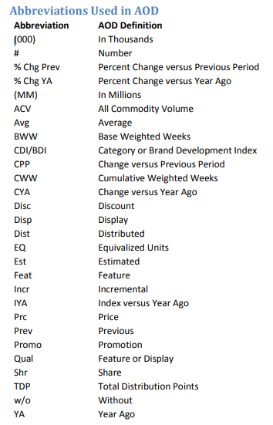
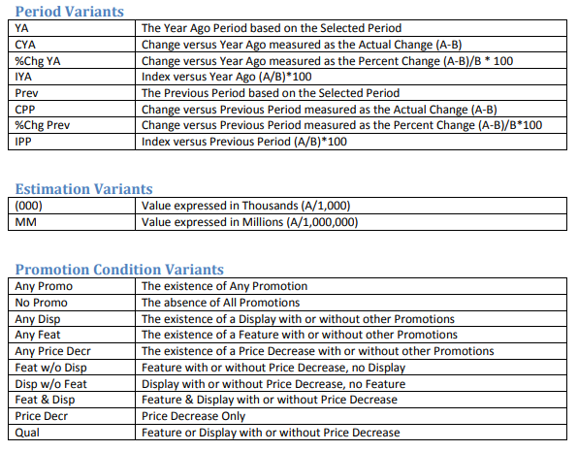
Abbreviations & Variants Used in AOD
Source: NIQ

Slide 54
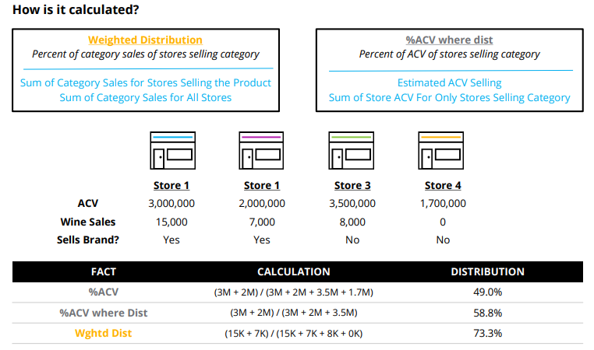
Weighted Distribution
MOVE FROM “%ACV WHERE DIST” TO “WGHTD DIST” AS STANDARD BEVAL DISTRIBUTION MEASURE
What is Weighted Distribution?
Weighted Distribution, often referred to as “Category Weighted Distribution”, is a better indicator of where consumers look to buy a particular category or product.
While “%ACV where Dist” is often used as a rough surrogate for Weighted Dist, the risk of using ACV alone is over-emphasizing high traffic stores where a product category may be available, but not purchased at a rate indicative of the store’s overall volume.
Source: NIQ

